Slide 1
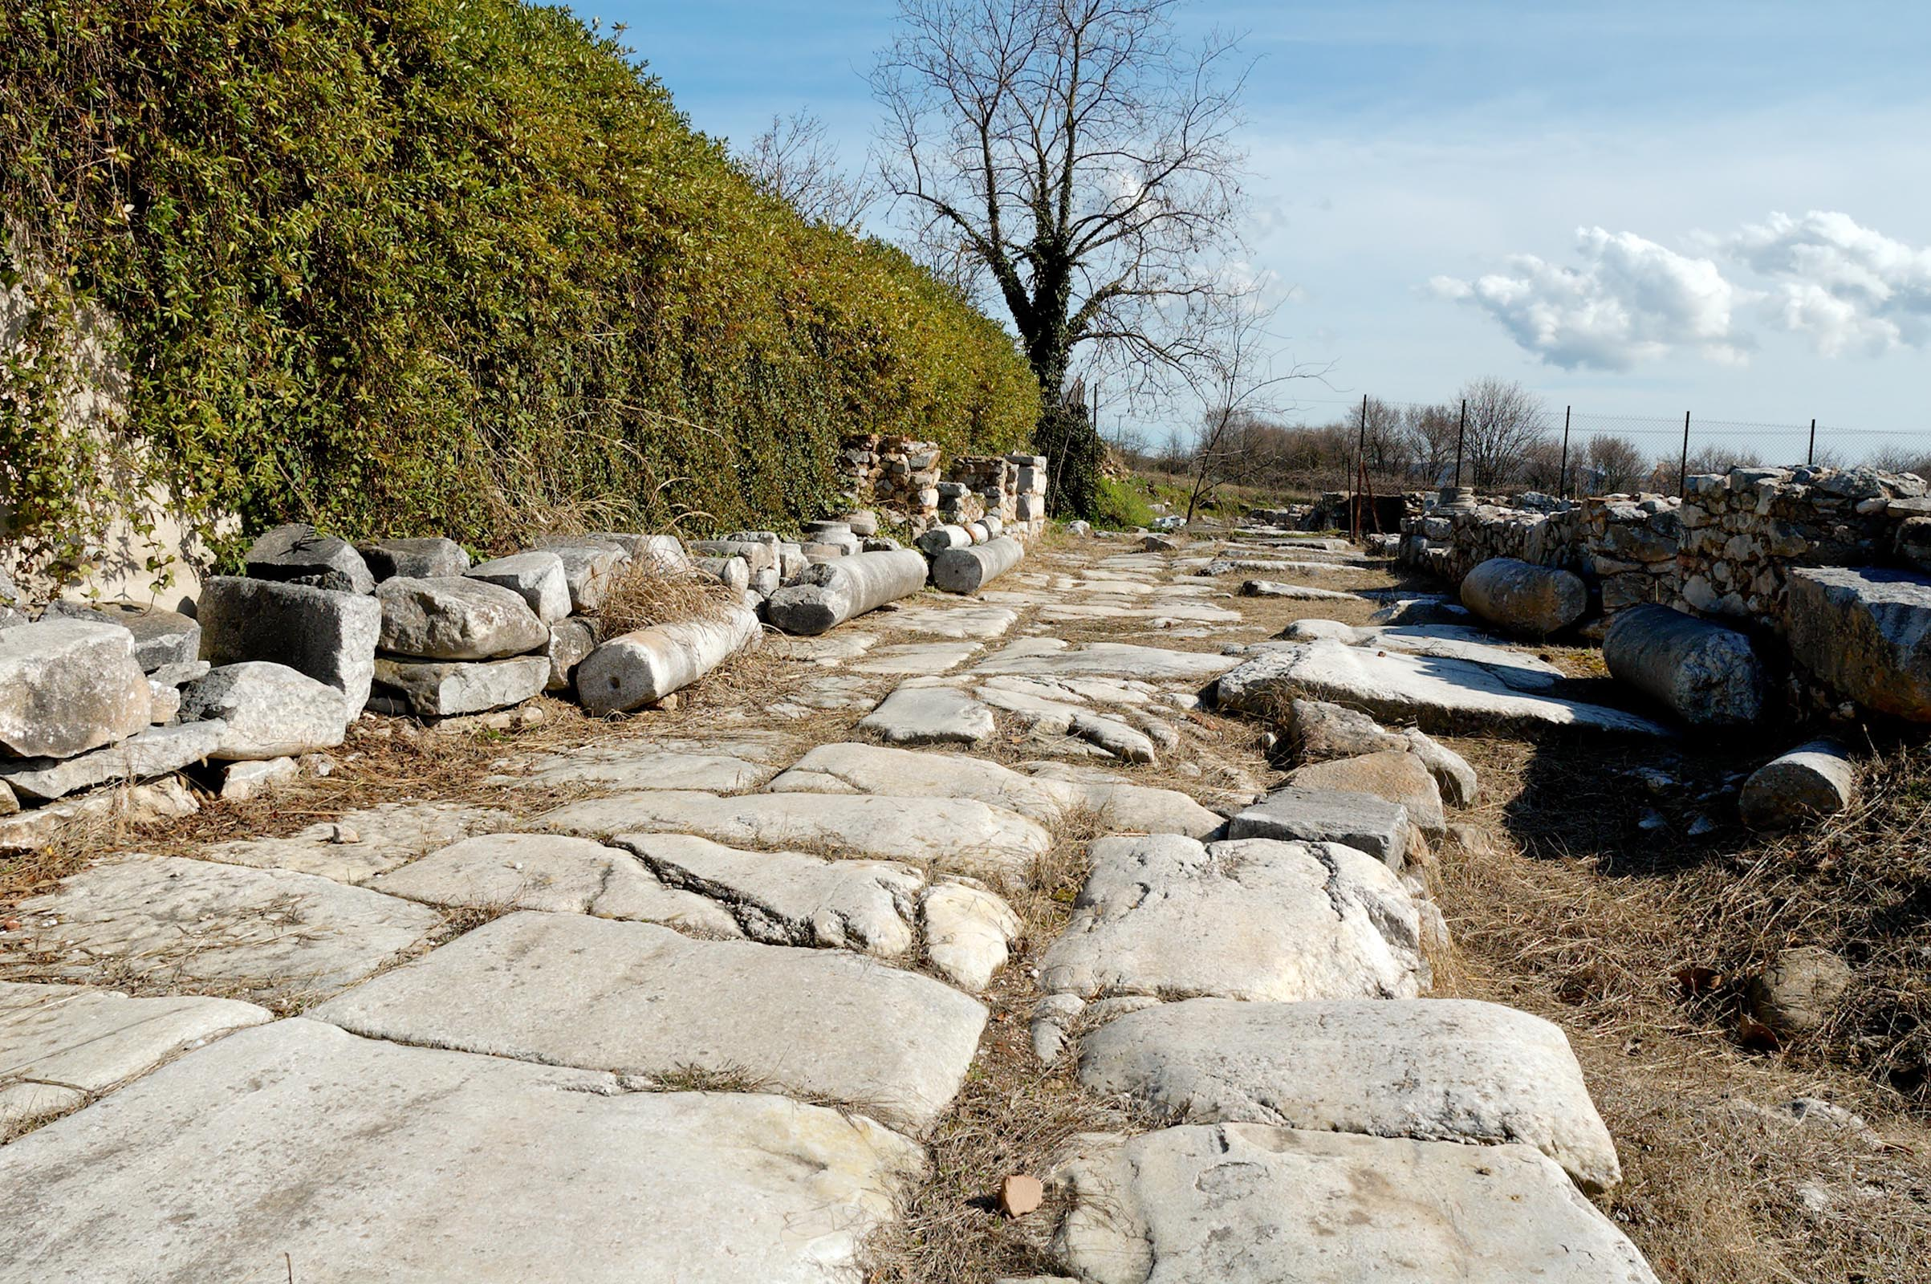
Philippians 1.27-30
Roman highway through ancient Philippi / ©2012 Todd Bolen / BiblePlaces.com

Slide 2
Philippians 1.27-28 NET: Only conduct yourselves in a manner worthy of the gospel of Christ so that– whether I come and see you or whether I remain absent– I should hear that you are standing firm in one spirit, with one mind, by contending side by side for the faith of the gospel, and by not being intimidated in any way by your opponents. This is a sign of their destruction, but of your salvation– a sign which is from God.

Slide 3
Philippians 1.27-28 NET: Only conduct yourselves in a manner worthy of the gospel of Christ ...
In salvation, God justified us, he declared us to be legally righteous in his sight.
He did this by imputing [accounting] to us the righteousness of Christ.
Now we learn how to live up to that righteousness!

Slide 4
Philippians 1.27-28 NET: Only conduct yourselves in a manner worthy of the gospel of Christ so that– whether I come and see you or whether I remain absent– I should hear that you are standing firm in one spirit, with one mind, by contending side by side for the faith of the gospel, and by not being intimidated in any way by your opponents. This is a sign of their destruction, but of your salvation– a sign which is from God.

Slide 5
Philippians 1.27-28 NET: Only conduct yourselves in a manner worthy of the gospel of Christ so that– whether I come and see you or whether I remain absent– I should hear that you are standing firm in one spirit, with one mind, by contending side by side for the faith of the gospel, and by not being intimidated in any way by your opponents. This is a sign of their destruction, but of your salvation– a sign which is from God.
πτύρω describes a horse that shies in battle.

Slide 6
Philippians 1.27-28 NET: Only conduct yourselves in a manner worthy of the gospel of Christ so that– whether I come and see you or whether I remain absent– I should hear that you are standing firm in one spirit, with one mind, by contending side by side for the faith of the gospel, and by not being intimidated in any way by your opponents. This is a sign of their destruction, but of your salvation– a sign which is from God.

Slide 7
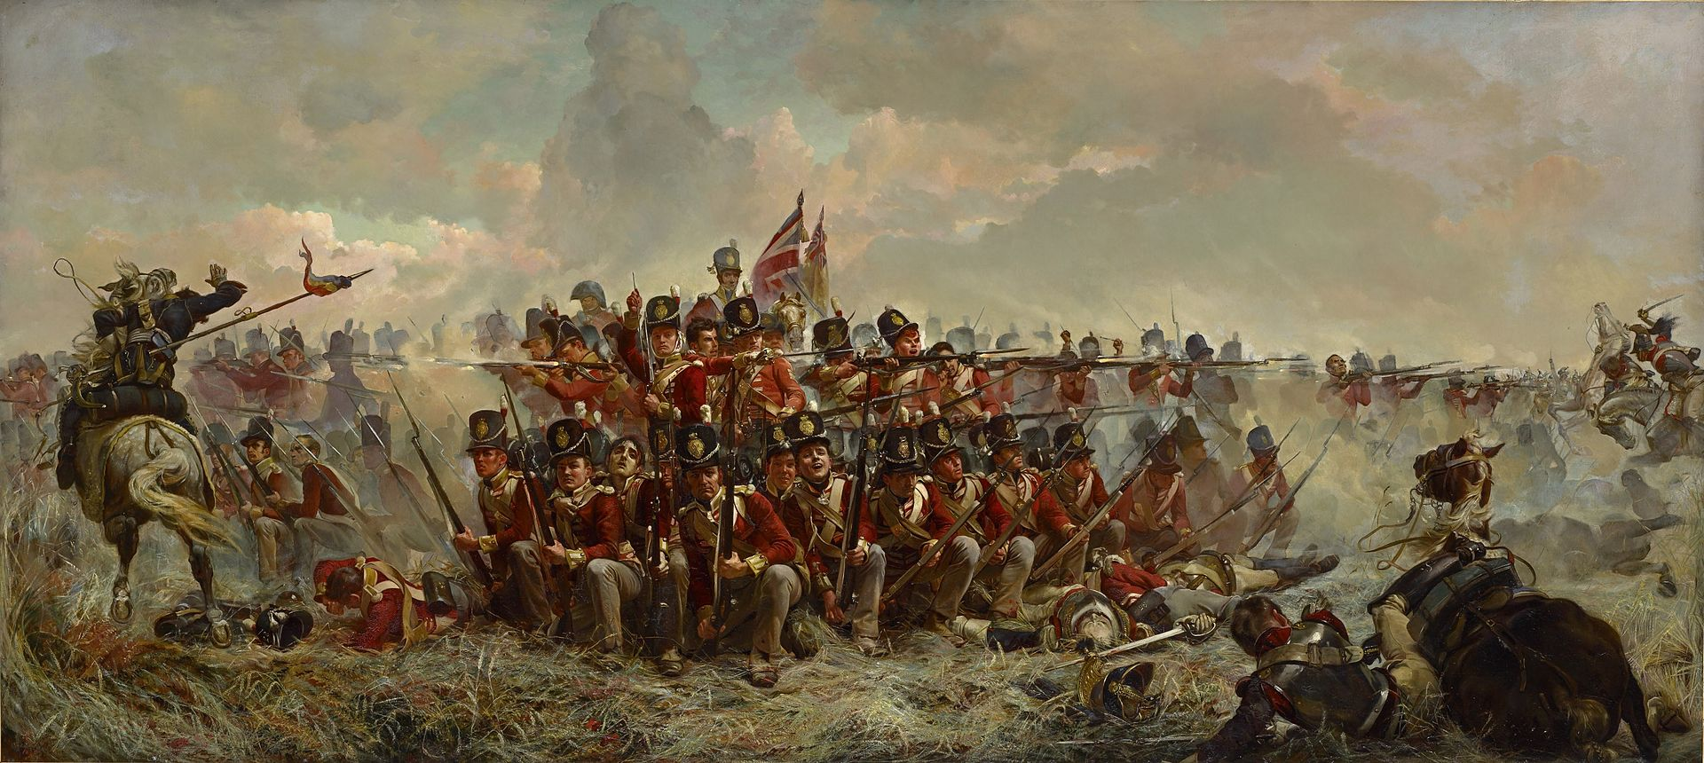
Infantry forming square to defend against a cavalry charge
Elizabeth Thompson / on display at National Gallery of Victoria

Slide 8
Philippians 1.27-28 NET: Only conduct yourselves in a manner worthy of the gospel of Christ so that– whether I come and see you or whether I remain absent– I should hear that you are standing firm in one spirit, with one mind, by contending side by side for the faith of the gospel, and by not being intimidated in any way by your opponents. This is a sign of their destruction, but of your salvation– a sign which is from God.
ἀπώλεια = destruction or utter ruin.

Slide 9
Philippians 1.27-28 NET: Only conduct yourselves in a manner worthy of the gospel of Christ so that– whether I come and see you or whether I remain absent– I should hear that you are standing firm in one spirit, with one mind, by contending side by side for the faith of the gospel, and by not being intimidated in any way by your opponents. This is a sign of their destruction, but of your salvation– a sign which is from God.

Slide 10
Philippians 1.27 NET: Only conduct yourselves in a manner worthy of the gospel of Christ …
πολιτεύομαι = I lead my life
[related to citizenship duties]
Philippians 1.27 NLT: Above all, you must live as citizens of heaven, conducting yourselves in a manner worthy of the Good News about Christ.

Slide 11
Philippians 1.29-30 NET: For it has been granted to you not only to believe in Christ but also to
suffer for him, since you are encountering
the same conflict that you saw me face and
now hear that I am facing.
χαρίζομαι = to give freely
χάρις = grace

Slide 12
Philippians 1.29-30 NET: For it has been granted to you not only to believe in Christ but also to suffer for him, since you are encountering the same conflict that you saw me face and now hear that I am facing.

Slide 13
2 Timothy 3.12 NET: Now in fact all who want to live godly lives in Christ Jesus will be persecuted.

